Slide 1



Slide 2
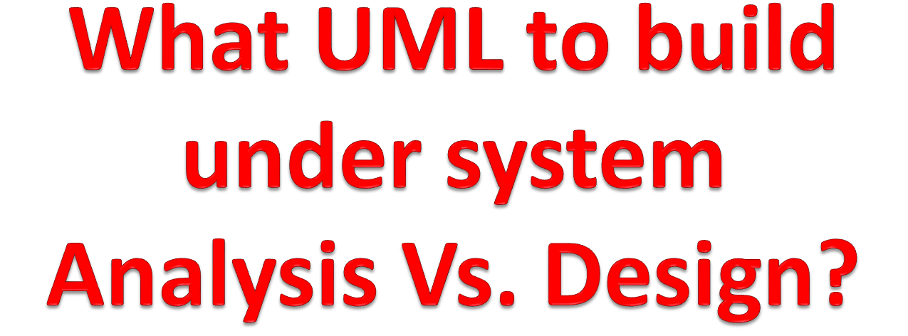

Slide 3
Unified Modelling Language (UML)
The Unified Modeling Language (UML) is a graphical language for OOAD that gives a standard way to write a software system’s blueprint.
It helps to visualize, specify, construct, and document the artifacts of an object-oriented system. It is used to depict the structures and the relationships in a complex system.

Slide 4
UML: Analysis
What UML model to build under analysis. The following:
These are:
  Use case Diagram
  Sequence diagram
  CRC(Class Responsibility and Collaboration)
  Class diagram
  Activity Diagram

Slide 5
UML: Design
What UML model to build under Design.
These are:
  Refined sequence Diagram
  Collaboration Diagram
  State chart diagram
  Component Diagram
  Deployment Diagram
  Refined class diagram
  Physical Data Modelling (PDM)
  Graphical User Interface

Slide 6
UML - Modeling Types
Any system can have two aspects, static and dynamic. So, a model is considered as complete when both the aspects are fully covered.
Structural Modeling/Diagrams
Structural modeling captures the static features of a system. They consist of the following −
Classes diagrams
Objects diagrams
Deployment diagrams
Component diagram

Slide 7
Cont:
Structural model represents the framework for the system and this framework is the place where all other components exist. Hence, the class diagram, component diagram and deployment diagrams are part of structural modeling. They all represent the elements and the mechanism to assemble them.
The structural model never describes the dynamic behavior of the system. Class diagram is the most widely used structural diagram.
The structural diagrams represent the static aspect of the system. These static aspects represent those parts of a diagram, which forms the main structure and are therefore stable.

Slide 8
Class Diagram
Class diagrams are the most common diagrams used in UML. Class diagram consists of classes, interfaces, relationships, and collaboration.
Class diagrams basically represent the object-oriented view of a system, which is static in nature.
A class is a set of objects that share a common structure and common behavior (the same attributes, operations and semantics).
A class is an abstraction of real-world items.

Slide 9
Cont.…
Classes are depicted as boxes with three sections:
  the top one indicates the name of the class,
  the middle one lists the attributes of the class, and
  the third one lists the methods.
Or a class can have two sections,
  one for the name and
  one for the responsibilities.

Slide 10
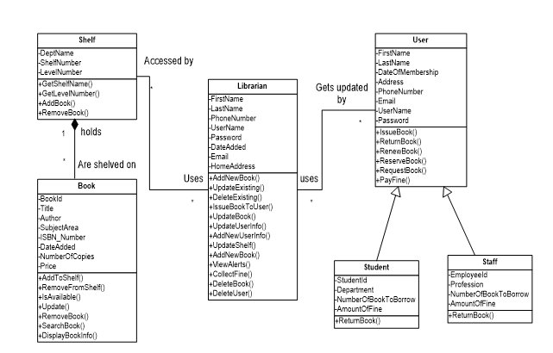
Analysis Class Diagram

Slide 11
To create and evolve a class model, you need to model these items:
  Classes;
  Responsibilities(Attributes and methods);
  Associations;
  Dependencies;
  Inheritance relationships;
  Composition associations; and
  Association classes.

Slide 12
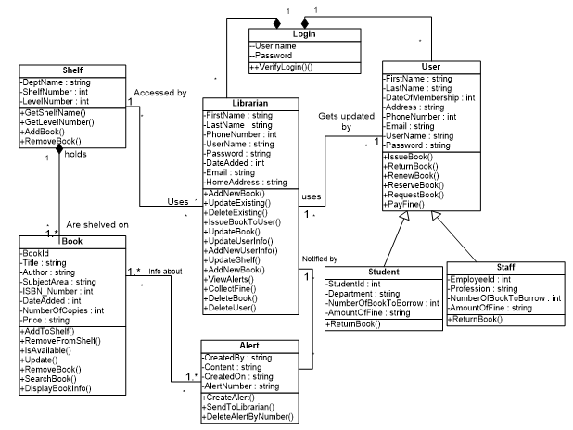
Design Class Diagram

Slide 13
Object diagram
Object diagrams can be described as an instance of class diagram. Thus, these diagrams are more close to real-life scenarios where we implement a system.
Object diagrams are a set of objects and their relationship is just like class diagrams. They also represent the static view of the system.
The usage of object diagrams is similar to class diagrams but they are used to build prototype of a system from a practical perspective.

Slide 14
Component diagram
Component diagrams represent a set of components and their relationships.
  Used to model physical aspects of a system
These components consist of classes, interfaces, or collaborations.
Component diagrams represent the implementation view of a system.
During the design phase, software artifacts (classes, interfaces, etc.) of a system are arranged in different groups depending upon their relationship. Now, these groups are known as components.
Finally, it can be said component diagrams are used to visualize the implementation.

Slide 15
Cont…
These diagrams also show the externally visible behavior of the component by displaying the interfaces of the components.
Components
Interfaces
Dependency relationship.
Component diagrams
  Models business and technical software architecture
  Uses components defined in the composite structure diagrams, in particular their ports and interfaces

Slide 16
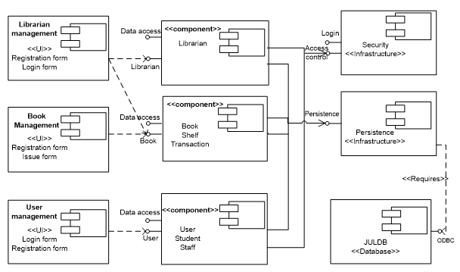
Component diagram for Library Management system

Slide 17
Deployment Diagrams
Deployment diagrams are a set of nodes and their relationships.
These nodes are physical entities where the components are deployed.
Used to visualize the topology of the physical components of a system
where the software components are deployed.
A deployment diagram shows processors, devices and connections. Each model contains a single deployment diagram which shows the connections between its processors and devices and its processes to processors.

Slide 18
Cont…
Deployment diagrams
  Models the physical software architecture, including issues such as the hardware, the software installed on it and the middleware
  Gives a static view of the run-time configuration of processing nodes and the components that run on those nodes

Slide 19
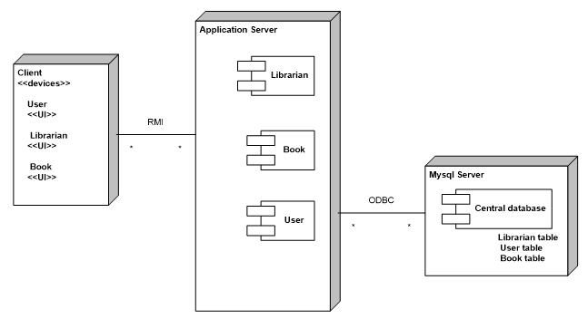
Deployment diagram for Library Management system

Slide 20
Behavioral Modeling
Behavioral diagrams basically capture the dynamic aspect of a system.
It represents the interaction among the structural diagrams.
Dynamic aspect can be further described as the changing/moving part of the system
All the above show the dynamic sequence of flow in a system.
Use case diagrams
Sequence Diagram
Collaboration Diagram
State chart Diagram
Activity diagrams

Slide 21
Use Case Diagram
Use case diagrams are a set of use cases, actors, and their relationships. They represent the use case view of a system.

Slide 22
Before designing use case, there are rules to follow:
For use case we analysis:
Use case ID: example UC1: Login
Pre-condition
Post-condition
Main course of action
Alternative course of action
Include and Extend
Supplementary Specification:

Slide 23
Post-condition and Pre-condition:
Preconditions describe the state or status the system must be in, prior to the execution of a use case. What must be true before the use case can execute?
Postconditions describe the state or status of the system as a result of the execution of the use case.

Slide 24
Supplementary specifications:
A supplementary specification is a document that contains requirements not contained directly in your use cases.
  business rules,
  technical requirements, and
  Constraints
  glossary
  1. Business rules
  Rules that influence the behavior of your business
  focus on access control issues;
  Some business rules focus on the policies of your organization

Slide 25
Examples1:
professors are allowed to input and modify the marks of the students taking the seminars they instruct, but not the marks of students in other seminars
how to convert a percentage mark (for example, 91 percent) that a student receives in a seminar into a letter grade (example, A-).
each business rule has a unique identifier. The convention is to use the format of BR#, but you are free to set your own numbering approach.
unique identifier enables you to refer easily to business rules in other development artifacts, such as class models and use cases

Slide 26
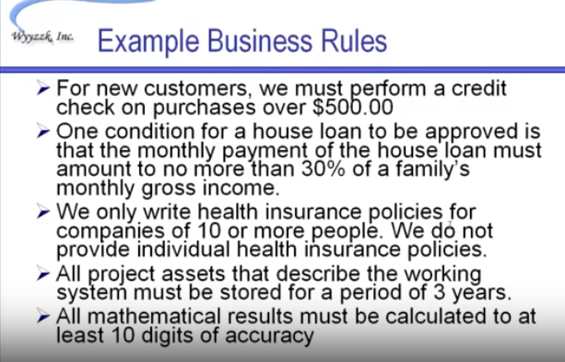

Examples2:

Slide 27
How to write business rule
Name. should give you a good idea about the topic of the business rule.
Description. defines the rule exactly.
Example (optional).
Source (optional). The source of the rule is indicated so it may be verified (it is quite common that the source of a rule is a person, one of your project stakeholders, or a team of people).

Slide 28
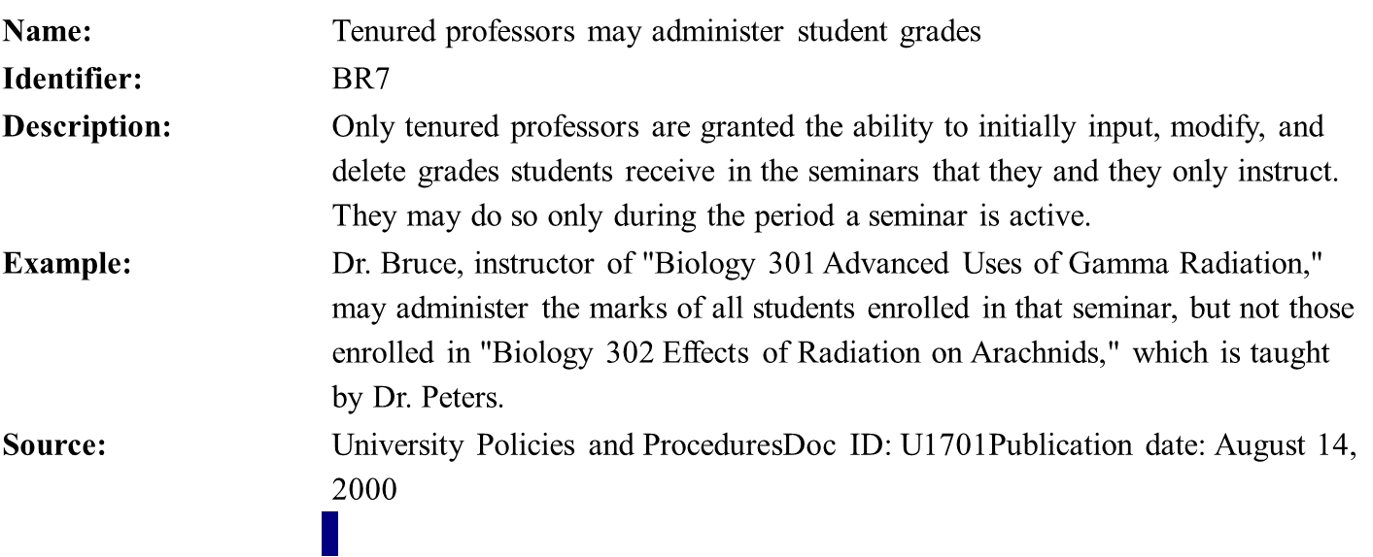
Example:
BR1 Tenured professors may administer student grades.
BR2 Teaching assistants who have been granted authority by a tenured professor may administer student grades.
BR3 Table to convert between numeric grades and letter grades.
BR4 All master's degree programs must include the development of a thesis.

Slide 29
Technical Requirements
Focuses on performance-related issues, reliability issues, and availability issues
are often called service-level requirements or nonfunctional requirements

Slide 30
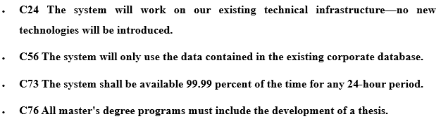
Technical Constraints
Restriction on the degree of freedom you have in providing a solution
It can be economic, political, technical, or environmental and pertain to your project resources, schedule, target environment, or to the system itself
Like business rules and technical requirements, constraints are documented in a similar manner.
Example 1:

Slide 31
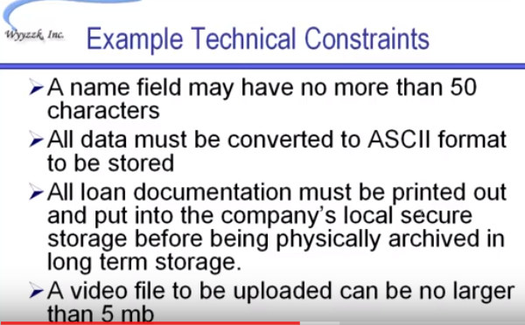
Example2:

Slide 32
Glossaries
collection of definitions of both technical and business terms which can improving the communications between developers and users.
For example: Terms that stakeholders likely do not know such as XP, C#, J2EE, Application server and terms that developers may not know such as convocation, grant, and transcript etc.
Identify and documenting Change Cases
used to describe new potential requirements for a system or modifications to existing requirements

Slide 33
Cont…
Change cases are modeled in a simple manner.
  You describe the potential change to your existing requirements,
  indicate the likeliness of that change occurring, and
  indicate the potential impact of that change
can be identified throughout the course of your overall development and are often the result of brainstorming with your project stakeholders

Slide 34
Others
Change case: Need to support both Linux and Microsoft platforms.
Likelihood: Very likely to happen for application and database servers within six months; medium probability that Linux will be adopted by the school for desktop machines.
Impact: Unknown. Currently application servers for other applications run Microsoft-based operating systems and will likely continue to do so. New servers will likely have Linux installed. Desktop impact is hard to quantify as the Linux market is evolving rapidly. Should be re-evaluated six months from now.

Slide 35
Example:
Change case: The University will open a new campus.
Likelihood: Certain. It has been announced that a new campus will be opened in two years across town.
Impact: Large. Students will be able to register in classes at either campus. Some instructors will teach at both campuses. Some departments, such as Computer Science and Philosophy, are slated to move their entire programs to the new campus. The likelihood is great that most students will want to schedule courses at only one of the two campuses, so we will need to make this easy to support

Slide 36
Include and Extend
The relationship between Use cases can be reused and extended in two different fashions: extends and include.
In the cases of “include” relationship, we define that one use case invokes the steps defined in another use case during the course of its own execution. Hence this defines a relationship that is similar to a relationship between two functions where one makes a call to the other function.
The “extends” relationship is kind of a generalization-specialization relationship. In this case a special instance of an already existing use case is created. The new use case inherits all the properties of the existing use case, including its actors.

Slide 37
Cont…
Extend :<<extend>>
  When the extending use case activity sequence is completed, the base use case continues.
  An extending use case is, effectively, an alternate course of the base use case.
  Ex. Enroll in University is the base use case and Perform Security Check is the extending use case. Step 7
Include: <<include>>
  formerly known as a uses relationship in UML v1.2 and earlier
  is a generalization relationship denoting the inclusion of the behavior described by another use case
  is the invocation of a use case by another one
  Used whenever one use case needs the behavior of another
  Ex. If a student is enrolled in a university, he/she can enroll in a seminar . Step 11

Slide 38
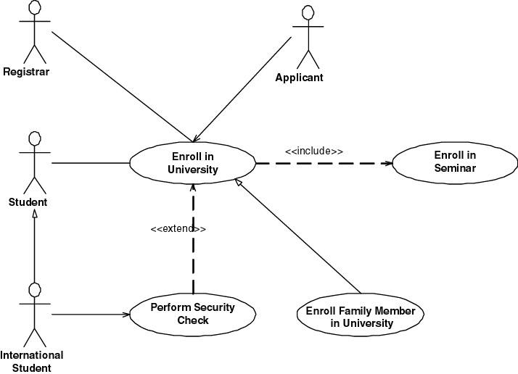
Cont…

Slide 39
Cont…
Inheritance between use cases
  Use cases can inherit from other use case. It is not as common as the use of either extend or include associations, but it is still possible
  The inheriting use case would completely replace one or more of the courses of action of the inherited use case
  Ex. that Enroll Family Member in University inherits from the Enroll in University use case (in this case, to reflect that new business rules are applied when the family member of a professor is enrolling at the university)
  It should have a name, description, and identifier, and it should indicate from which use case it inherits (If something is not replaced, then leave that section blank, assuming it is inherited from the parent use case)
Inheritance between actors
  an actor on a use case diagram can inherit from another actor
  Ex. International Student actor inherits from Student.
  International student is subjected to different rules and policies (pay more and undergo a security check during registration process)

Slide 40
Example:
Login
ID: UC1
Actor: librarian
Pre-condition: the librarian/user should have their user name and password to login.
Post-condition: the main page of the system should display on the screen.
Include: user database.

Slide 41
Example: cont…
Main course of action: step by step
An authorized librarian/user want to login to the system.
The librarian/user click on login form.
The system asks user name and password to the login to the system.
Then enter his/her username and password to login form and click on login.
The system checks and authenticates the librarian/user.
The database accepts the username and password of the librarian/user.
Then the main page will be displayed to the users.

Slide 42
Example: cont…
Best practices in writing Alternate Courses of Action
Briefly describe the condition: description of the condition that must be met to invoke the alternate course
Indicate that the alternate course exists within the basic course of action. (Specify the alternate course name)
Set a consistent step numbering strategy: each step starts with the letter of the alternate course, followed by the number of the step in the basic course of the use case it replaces
You need an identification scheme: identify the first alternate course as A, the second as B, and so on. Also, notice the numbering scheme for the steps of the alternate course.
End the alternate course: indicate either that the use case ends or the use case continues at another step

Slide 43
Example: cont…
Alternative course of action
A.5 If the user type wrong password or username.
A.6.The login controller initiates login.
A.7.The database authenticate the librarian/user.
A.8.The system display login form to the librarian/user continuously.

Slide 44
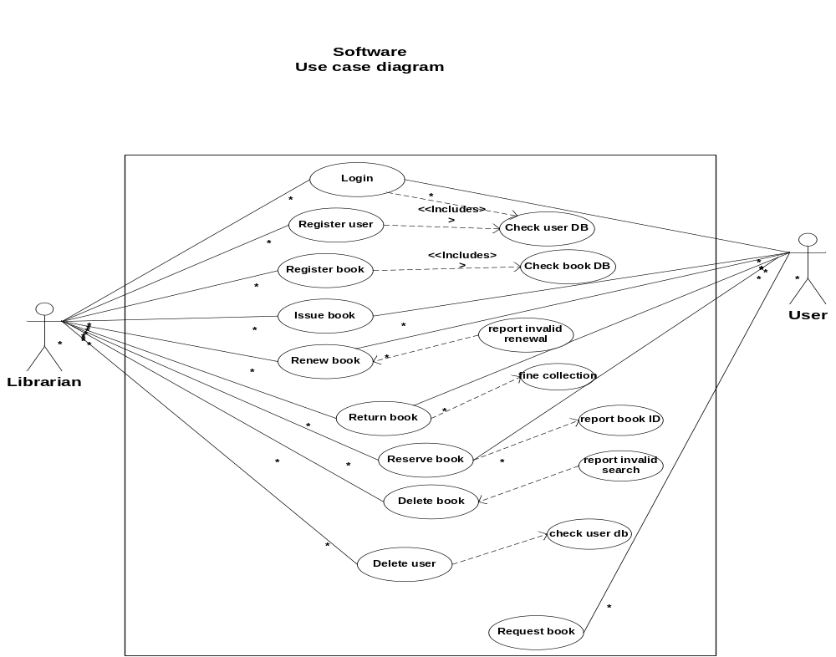

Slide 45
Interaction diagrams is part of Behavioral diagram
Interaction is basically a message exchange between two UML components. The following diagram represents different notations used in an interaction.
Interactions can be of two types −
Sequential (Represented by sequence diagram)
Collaborative (Represented by collaboration diagram)

Slide 46
Cont…
Sequence Diagrams: A sequence diagram is a graphical view of a scenario that shows object interaction in a time based sequence, what happens first, what happens next.
Sequence diagrams establish the roles of objects and help provide essential information to determine class responsibilities and interfaces.
A sequence diagrams in design phases are a refined diagrams with additional details of activities.

Slide 47
Rules in drawing a sequence diagram
  the horizontal arrows shows the message : the first message starts in the top left corner; the next message appears just below that one
  The boxes across the top of the diagram represent classifiers or their instances; typically use cases, objects, classes, or actors
    Objects have labels in the standard UML format name: ClassName (name is optional, if object has no name “Anonymous”) and object labels are underlined
    Classes have labels in the format ClassName, and
    Actors have names in the format Actor Name.
  The dashed lines hanging from the boxes are called object lifelines, representing the life span of the object during the scenario being modeled.
  The long, thin boxes on the lifelines are activation boxes, also called method-invocation boxes, which indicate processing is being performed by the target object/class to fulfill a message.

Slide 48
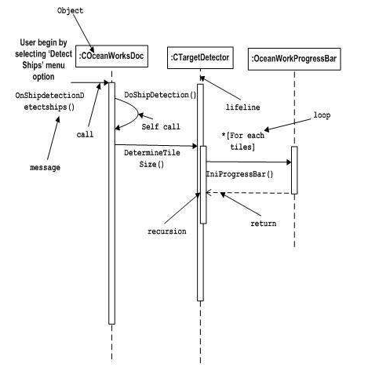
Cont…

Slide 49
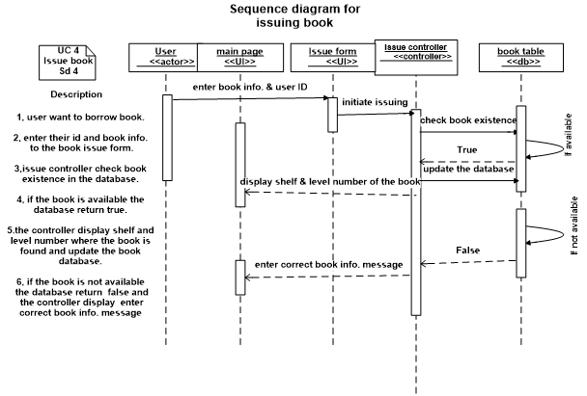
Analysis Sequence Diagram

Slide 50
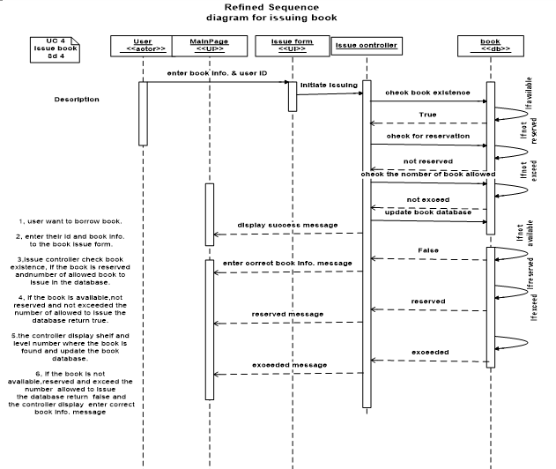
Design Sequence Diagram

Slide 51
Collaboration Diagram
It represents the structural organization of a system and the messages sent/received. Structural organization consists of objects, links and messages.
Order of messages that implement an operation or a transaction. They can also contain simple class instances and class utility instances
The purpose of collaboration diagram is similar to sequence diagram. However, the specific purpose of collaboration diagram is to visualize the organization of objects and their interaction.

Slide 52
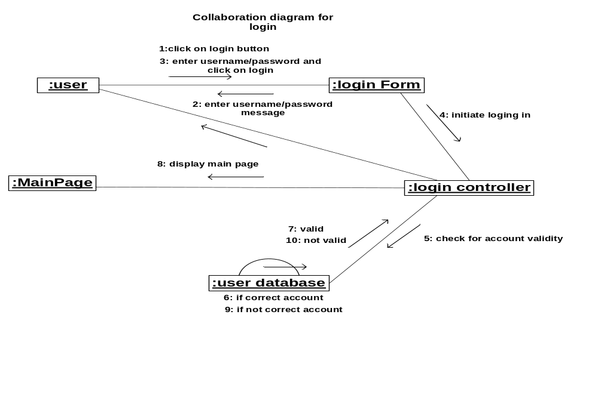
Cont…

Slide 53
State Machine Notation
State machine describes the different states of a component in its life cycle. The notations are described in the following diagram.
State machine is used to describe different states of a system component.
The state can be active, idle, or any other depending upon the situation.

Slide 54
Cont.…
State chart diagram: state chart diagrams model the dynamic behavior of individual classes or any other kind of object.
They show the sequence of states that an object goes through the events that cause a transition from one state to another and the actions that result from a state change.
A state chart diagram is typically used to model the discrete stages of an objects lifetime.

Slide 55
Essential elements of state chart diagram
State: - A state represents a condition or situation during the life of an object during which it satisfies some condition or waits for an event. Each state represents a cumulative history of its behavior.
States can be shared between state machines. Transitions cannot be shared

Slide 56
cont.…
Start state:- A start state (also called an “initial state”) explicitly shows the beginning of the execution of the state machine on the state chart diagram or beginning of the workflow on an activity diagram.
Normally, one outgoing transition can be placed from the start state.
End state: - An end state represents a final or terminal state on an activity or state chart diagram.
Transitions can only occur into an end state.
The end state icon is a filled circle inside a slightly larger unfilled circle that may contain the name (End process).

Slide 57
cont.…
State transition:- A state transition indicates that an action in the source state will perform certain specified actions and enter the destination state when a specified event occurs or when certain conditions are satisfied.

Slide 58
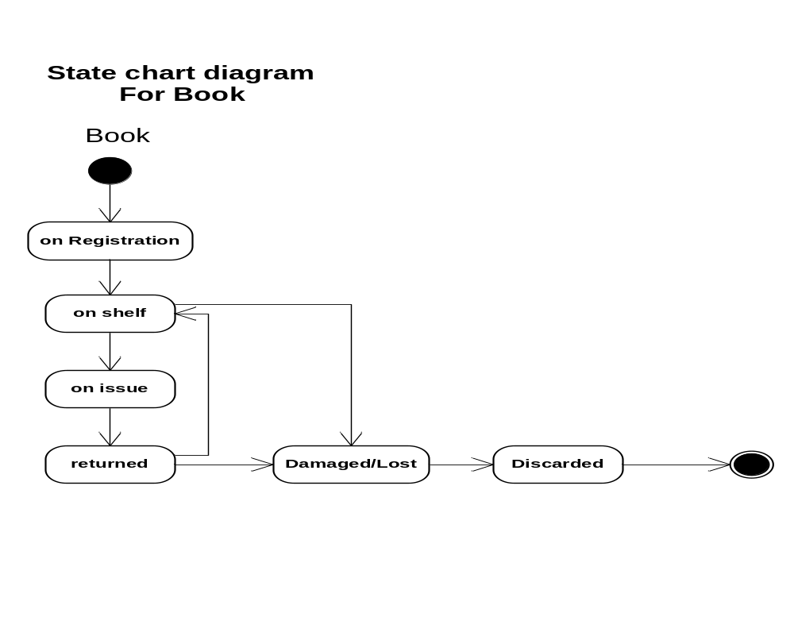
cont.…

Slide 59
Activity diagram
Activity diagram describes the flow of control in a system. It consists of activities and links. The flow can be sequential, concurrent, or branched.
Activities are nothing but the functions of a system. Numbers of activity diagrams are prepared to capture the entire flow in a system.
Activity diagrams are used to visualize the flow of controls in a system. This is prepared to have an idea of how the system will work when executed.

Slide 60
Cont…
Basic notations of Activity Diagram
  Initial node: filled circle is the starting point of the diagram
  final node. The filled circle with a border is the ending point (0 , >0)
  Activity. The rounded rectangles represent activities that occur (be physical, such as Inspect Forms, or electronic, such as Display Create Student Screen)
  Flow/edge. The arrows on the diagram
  Condition. Text such as [Incorrect Form] on a flow
  Decision. A diamond with one flow entering and several leaving

Slide 61
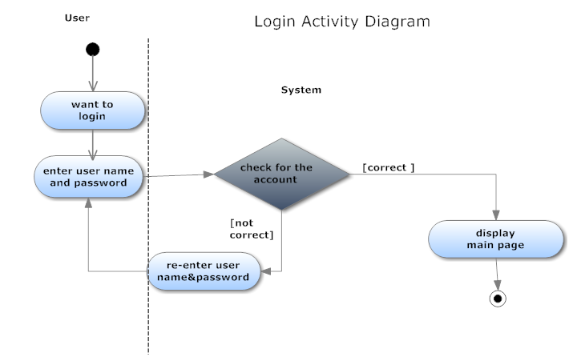
Cont.…

Slide 62
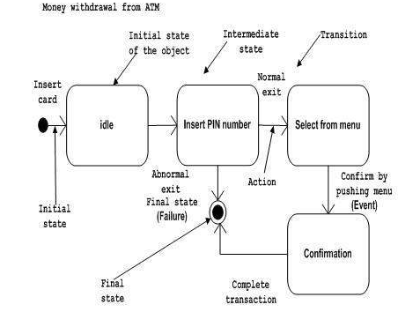
Cont…

Slide 63
Physical Data Modelling (PDM)
Purpose of PDM diagrams:
  design the internal schema of a database,
  depicting the data tables,
  the data columns of those tables, and
  the relationships between the tables. (implemented using keys)

Slide 64
In designing a physical data model:
  Identify tables: Tables are the database equivalent of classes
  Normalize tables: to ensure that data are stored in only one place/table
  Identify columns: A column is the database equivalent of an attribute.
  Identify stored procedures: A stored procedure is conceptually similar to a global method implemented by the database.
  Identify relationships. There are relationships between tables just like there are relationships between classes.
  Assign keys. A key is one or more data attributes that uniquely identify a row in a table. <<PK>> Primary key and foreign keys <<FK>>.
  Finally show all the tables with their fields/attributes description

Slide 65
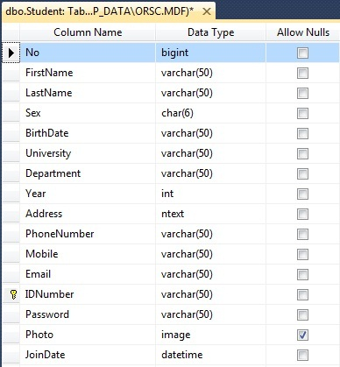

Slide 66
Graphical User Interface
    help the user to navigate through the system and enter data to the database, access and retrieve data from the database.
    Design class diagram will be converted to tables and tables will be converted to GUI
    Every table that is designed in the physical data model should have corresponding graphical user interface.
    Properly designed GUI have the following benefits:
      easier to use, easier to train people to use it(reduce training costs)
      less help people will need to use it (reduce your support costs)
      users will like to use it (increase their satisfaction)

Slide 67
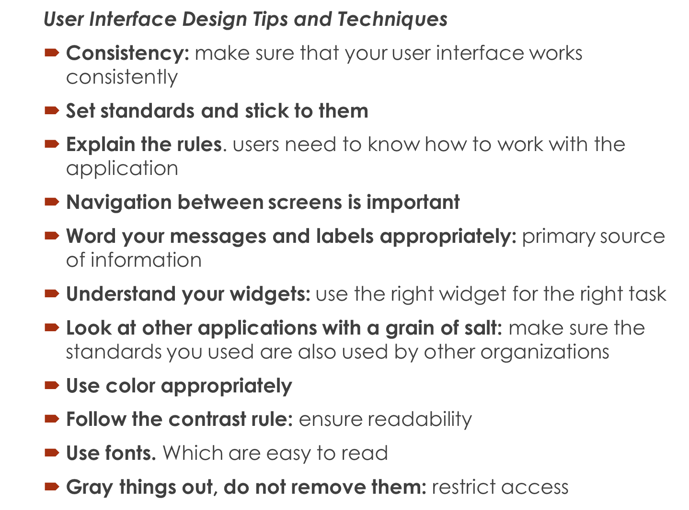

Slide 68
